Slide 1
Introduction and Overview
Eric Prebys, FNAL

Slide 2
It all started about energy and collision rate
To probe smaller scales, we must go to higher energy
To discover new particles, we need enough energy available to create them
The Higgs particle, the last piece of the Standard Model probably has a mass of about 150 GeV, just at the limit of the Fermilab Tevatron
Many theories beyond the Standard Model, such as SuperSymmetry, predict a “zoo” of particles in the range of a few hundred GeV to a few TeV
Of course, we also hope for surprises.
The rarer a process is, the more collisions (luminosity) we need to observe it.
~size of proton

Slide 3
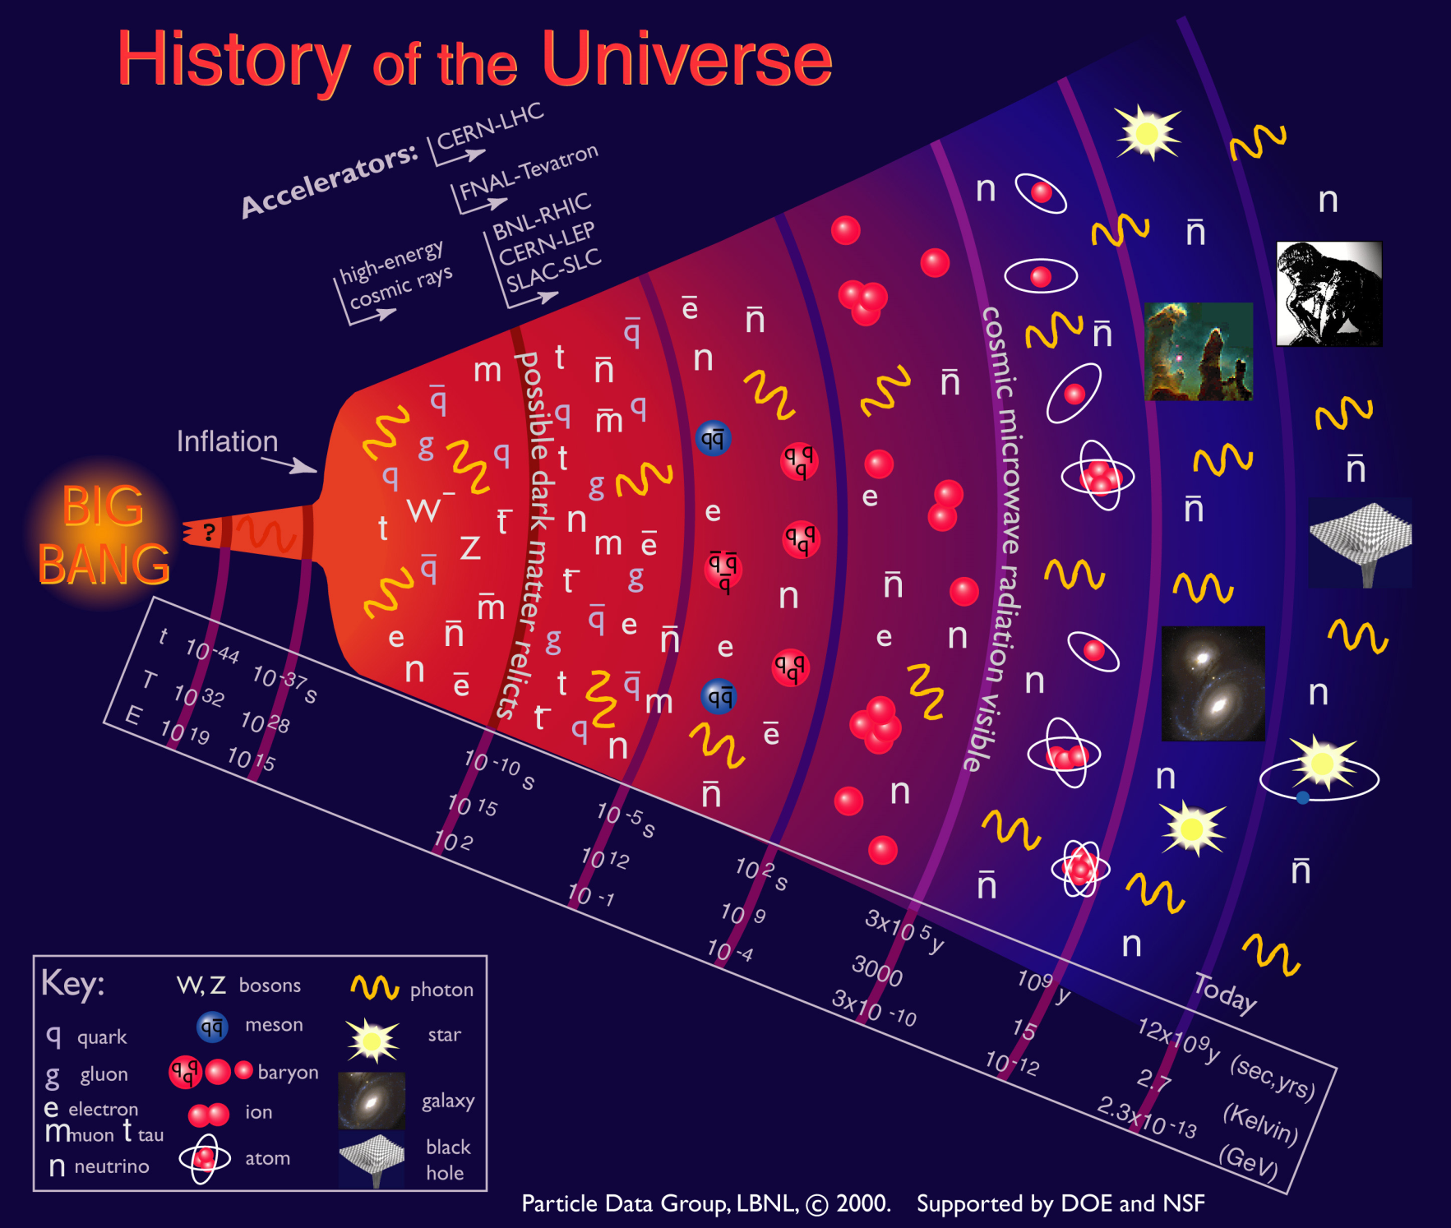
We’re currently probing down to a few picoseconds after the Big Bang

Slide 4
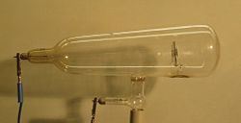
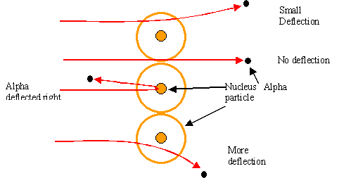
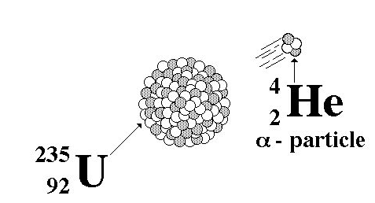
Some pre-history
The first artificial acceleration of particles was done using “Crookes tubes”, in the latter half of the 19th century
These were used to produce the first X-rays (1875)
But at the time no one understood what was going on
The first “particle physics experiment” told Ernest Rutherford the structure of the atom (1911)
In this case, the “accelerator” was a naturally decaying ²³⁵U nucleus
Study the way radioactive particles “scatter” off of atoms

Slide 5
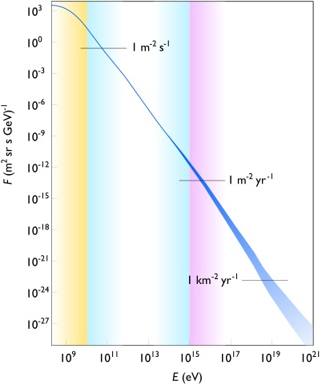
Natural particle acceleration
Max LHC energy
Radioactive sources produce maximum energies of a few million electron volts (MeV)
Cosmic rays reach energies of ~1,000,000,000 x LHC but the rates are too low to be useful as a study tool
Remember what I said about luminosity.
On the other hand, low energy cosmic rays are extremely useful
But that’s another talk

Slide 6
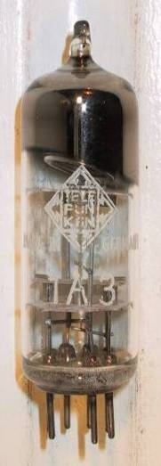
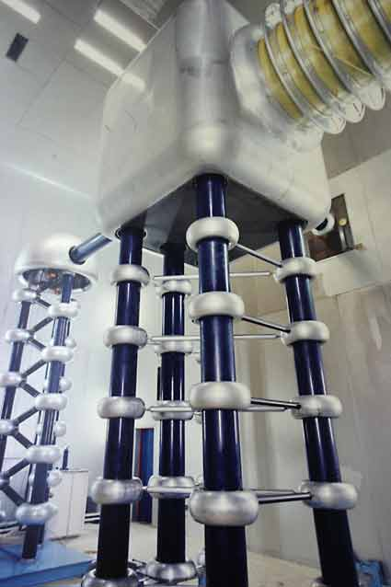
Man-made particle acceleration
The simplest accelerators accelerate charged particles through a static electric field. Example: vacuum tubes (or CRT TV’s)
Cathode
Anode
Limited by magnitude of static field:
- TV Picture tube ~keV - X-ray tube ~10’s of keV - Van de Graaf ~MeV’s
Solutions:
Alternate fields to keep particles in accelerating fields -> RF acceleration
Bend particles so they see the same accelerating field over and over -> cyclotrons, synchrotrons
FNAL Cockroft-Walton = 750 kV

Slide 7
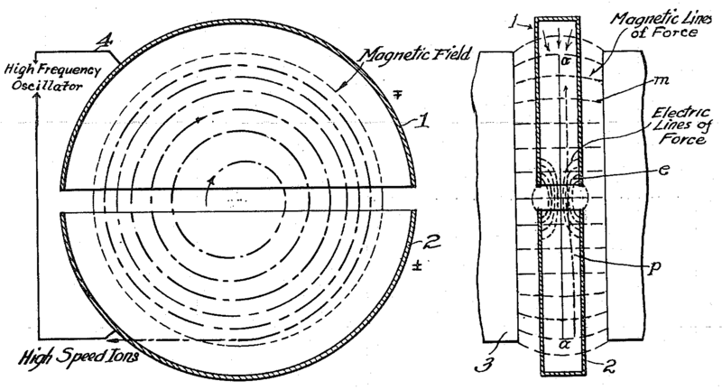
The Cyclotron (1930’s)
side view
top view
A charged particle in a uniform magnetic field will follow a circular path of radius
“Cyclotron Frequency”
Red box = remember!
For a proton:
Accelerating “DEES”

Slide 8
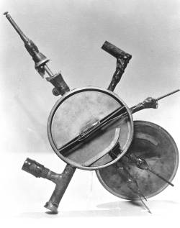
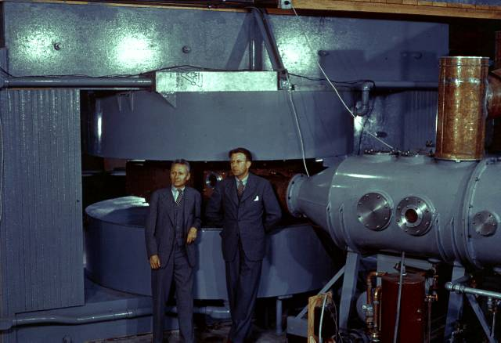
Round we go: the first cyclotrons
~1930 (Berkeley)
Lawrence and Livingston
K=80KeV
1935 - 60” Cyclotron
Lawrence, et al. (LBL)
~19 MeV (D2)
Prototype for many

Slide 9
Synchrocyclotron
Cyclotrons only worked up to about 20% of the speed of light (proton energies of ~15 MeV).
Beyond that
As energy increases, the driving frequency must decrease.
Higher energy particles take longer to go around. This has big benefits.
Particles with lower E arrive earlier and see greater V.
Phase stability!
Nominal Energy
(more about that shortly)

Slide 10
Synchrotrons and beam “stiffness”
The relativistic form of Newton’s Laws for a particle in a magnetic field is:
A particle in a uniform magnetic field will move in a circle of radius
In a “synchrotron”, the magnetic fields are varied as the beam accelerates such that at all points , and beam motion can be analyzed in a momentum independent way.
It is usual to talk about he beam “stiffness” in T-m
Thus if at all points , then the local bend radius (and therefore the trajectory) will remain constant.
Booster: (Bρ)~30 Tm
LHC : (Bρ)~23000 Tm

Slide 11
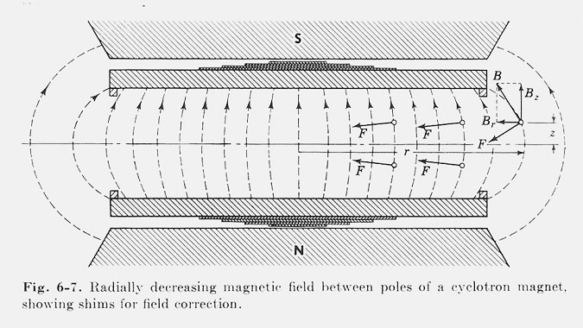
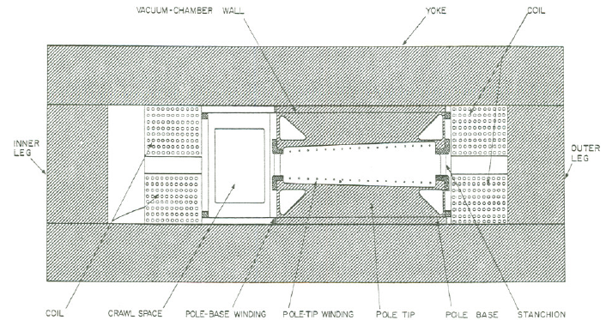
Weak focusing
Cyclotrons relied on the fact that magnetic fields between two pole faces are never perfectly uniform.
This prevents the particles from spiraling out of the pole gap.
In early synchrotrons, radial field profiles were optimized to take advantage of this effect, but in any weak focused beams, the beam size grows with energy.
The highest energy weak focusing accelerator was the Berkeley Bevatron, which had a kinetic energy of 6 GeV
High enough to make antiprotons (and win a Nobel Prize)
It had an aperture 12”x48”!

Slide 12
Strong focusing
Strong focusing utilizes alternating magnetic gradients to precisely control the focusing of a beam of particles
The principle was first developed in 1949 by Nicholas Christophilos, a Greek-American engineer, who was working for an elevator company in Athens at the time.
Rather than publish the idea, he applied for a patent, and it went largely ignored.
The idea was independently invented in 1952 by Courant, Livingston and Snyder, who later acknowledged the priority of Christophilos’ work.
Although the technique was originally formulated in terms of magnetic gradients, it’s much easier to understand in terms of the separate funcntions of dipole and quadrupole magnets.

Slide 13
Thin lens approximation and magnetic “kick”
If the path length through a transverse magnetic field is short compared to the bend radius of the particle, then we can think of the particle receiving a transverse “kick” and it will be bent through small angle
In this “thin lens approximation”, a dipole is the equivalent of a prism in classical optics.

Slide 14
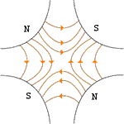
Quadrupole magnets*
A positive particle coming out of the page off center in the horizontal plane will experience a restoring kick
*or quadrupole term in a gradient magnet

Slide 15
What about the other plane?
Defocusing!
Luckily, if we place equal and opposite pairs of lenses, there will be a net focusing regardless of the order.
➔pairs give net focusing in both planes -> “FODO cell”

Slide 16
Trajectories and phase space
In general, we assume the dipoles define the nominal particle trajectory, and we solve for lateral deviations from that trajectory.
At any point along the trajectory, each particle can be represented by its position in “phase space”
Lateral deviation
s
x
Position along trajectory
We would like to solve for x(s)
We will assume:
Both transverse planes are independent
No “coupling”
All particles independent from each other
No space charge effects

Slide 17
Transfer matrices
The simplest magnetic lattice consists of quadrupoles and the spaces in between them (drifts). We can express each of these as a linear operation in phase space.
By combining these elements, we can represent an arbitrarily complex ring or line as the product of matrices.
Quadrupole:
Drift:

Slide 18
Example: FODO cell
At the heart of every beam line or ring is the “FODO” cell, consisting of a focusing and a defocusing element, separated by drifts:
The transfer matrix is then
We can build a ring out of N of these, and the overall transfer matrix will be
L
-L
f
-f

Slide 19
Betatron motion
Skipping a lot of math, we find that we can describe particle motion in terms of initial conditions and a “beta function” β(s), which is only a function of location in the nominal path.
Minor but important note: we need constraints to define β(s)
For a ring, we require periodicity (of β, NOT motion): β(s+C) = β(s)
For beam line: matched to ring or source
x
Lateral deviation in one plane
s
The “betatron function” β(s) is effectively the local wavenumber and also defines the beam envelope.
Phase advance
Closely spaced strong quads -> small β -> small aperture, lots of wiggles
Sparsely spaced weak quads -> large β -> large aperture, few wiggles

Slide 20
Betatron tune
Particle trajectory
As particles go around a ring, they will undergo a number of betatrons oscillations ν (sometimes Q) given by
This is referred to as the “tune”
Ideal orbit
We can generally think of the tune in two parts:
6.7
Fraction: Beam Stability
Integer : magnet/aperture optimization

Slide 21
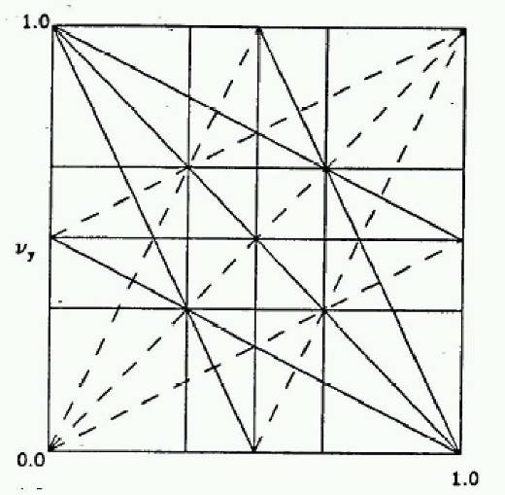
Tune, stability, and the tune plane
If the tune is an integer, or low order rational number, then the effect of any imperfection or perturbation will tend be reinforced on subsequent orbits.
When we add the effects of coupling between the planes, we find this is also true for combinations of the tunes from both planes, so in general, we want to avoid
Many instabilities occur when something perturbs the tune of the beam, or part of the beam, until it falls onto a resonance, thus you will often hear effects characterized by the “tune shift” they produce.
“small” integers
➔Avoid lines in the “tune plane”
fract. part of Y tune
fract. part of X tune

Slide 22
Twiss parameters: α, β, and γ
As a particle returns to the same point s on subsequent revolutions, it will map out an ellipse in phase space, defined by
As we examine different locations on the ring, the parameters will change, but the area (Aπ) remains constant.
Twiss Parameters

Slide 23
Emittance
If each particle is described by an ellipse with a particular amplitude, then an ensemble of particles will always remain within a bounding ellipse of a particular area:
Area = ε
Since these distributions often have long tails, we typically define the “emittance” as an area which contains some specific fraction of the particles. Typical conventions:
Electron machines, CERN:
Contains 39% of Gaussian particles
Usually leave π as a unit, e.g. E=12 π-mm-mrad
FNAL:
Contains 95% of Gaussian particles

Slide 24
Interpreting the twiss parameters
As particles go through the lattice, the Twiss parameters will vary periodically:
= max α = 0
➔maximum
= decreasing α >0
➔focusing
= min α = 0
➔minimum
= increasing α < 0
➔defocusing

Slide 25
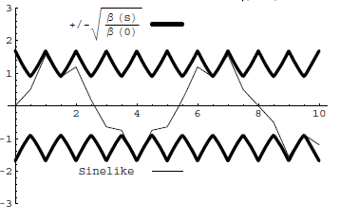
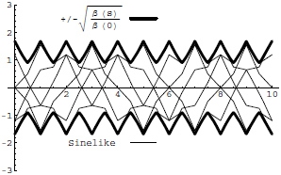
Conceptual understanding of β and ε
In this representation, we have separated the properties of the accelerator itself (Twiss Parameters) from the properties of the ensemble (emittance). At any point, we can calculate the size of the beam by
It’s important to remember that the betatron function represents a bounding envelope to the beam motion, not the beam motion itself
Normalized particle trajectory
Trajectories over multiple turns

Slide 26
Steering errors (or corrections)
A dipole magnet will perturb the trajectory of a beam as
A dipole perturbation in a ring will cause a “closed orbit distortion” given by We can create a localized distortion by introducing three angular kicks with ratios
These “three bumps” are a very powerful tool for beam control and tuning

Slide 27
Quadrupole errors
A single quadrupole of focal length f will introduce a tune shift given by Studying these tune shifts turn out to be one very good way to measure β(s) at quadrupole locations (more about that tomorrow).
In addition, a small quadrupole perturbation will cause a “beta wave” distortion of the betatron function around the ring given by

Slide 28
Dispersion and chromaticity
Up until now, we have assumed that momentum is constant.
Real beams will have a distribution of momenta.
The two most important parameters describing the behavior of off-momentum particles are
“Dispersion”: describes the position dependence on momentum
Most important in the bend plane
Chromaticity: describes the tune dependence on momentum.
Often expressed in “units” of 10⁻⁴

Slide 29
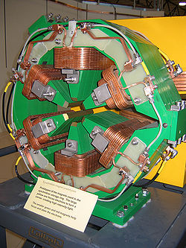
Sextupoles
Sextupole magnets have a field (on the principle axis) given by
If the magnet is put in a sufficiently dispersive region, the momentum-dependent motion will be large compared to the betatron motion,
The important effect will then be slope, which is effectively like adding a quadrupole of strength
The resulting tune shift will be
p=p₀+Δp
Nominal momentum
chromaticity

Slide 30
Longitudinal motion
We will generally accelerate particles using structures that generate time-varying electric fields (RF cavities), either in a linear arrangement or located within a circulating ring
In both cases, we want to phase the RF so a nominal arriving particle will see the same accelerating voltage and therefore get the same boost in energy
cavity 0
cavity 1
cavity N
Nominal Energy

Slide 31
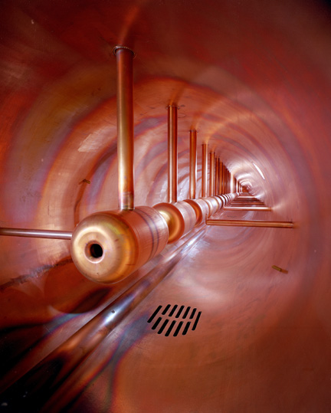
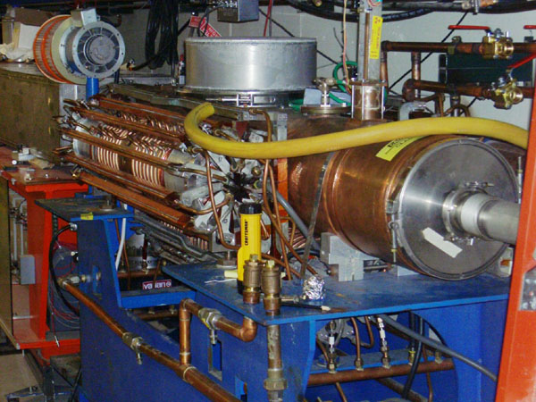
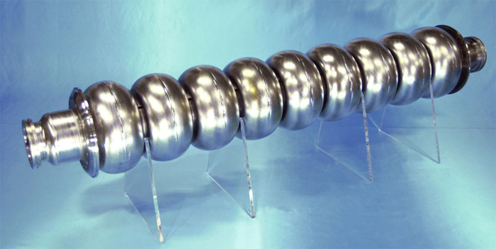
Examples of accelerating RF structures
37->53MHz Fermilab Booster cavity
Biased ferrite frequency tuner
Fermilab Drift Tube Linac (200MHz): oscillating field uniform along length
ILC prototype elipical cell “π-cavity” (1.3 GHz): field alternates with each cell

Slide 32
Phase stability
A particle with a slightly different energy will arrive at a slightly different time, and experience a slightly different acceleration
If then particles will stably oscillate around this equilibrium energy with a “synchrotron frequency” and “synchrotron tune”
Off Energy
Nominal Energy

Slide 33
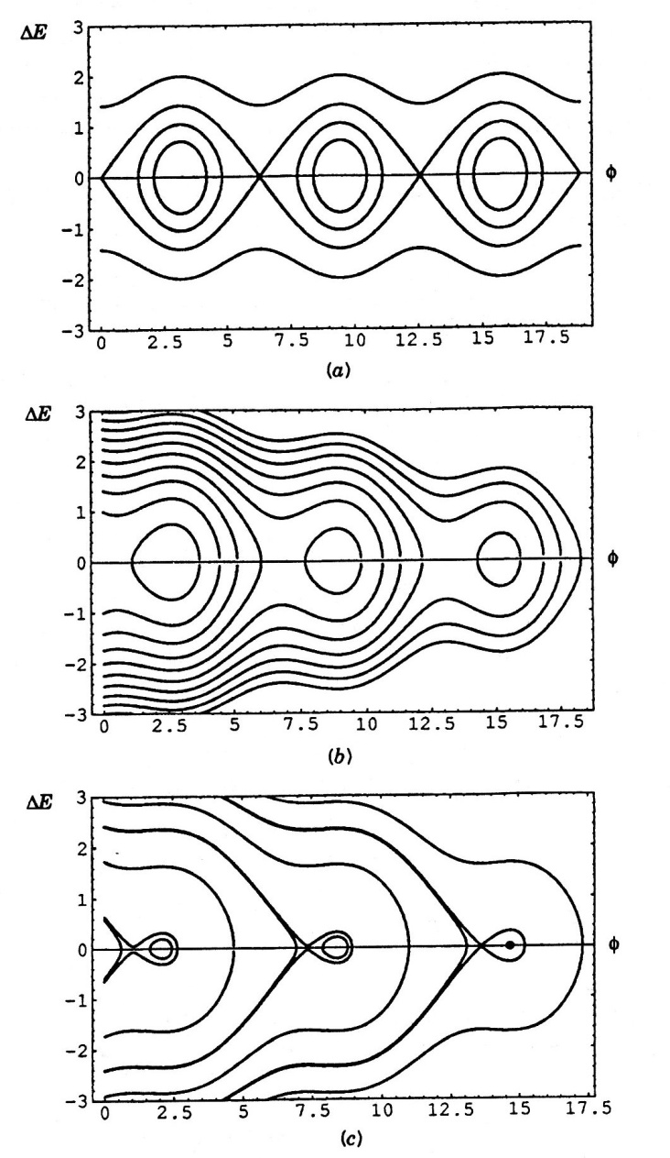
Accelerating phase and stability
The accelerating voltage grows as sinφ_{s}, but the stable bucket area shrinks
Just as in the transverse plane, we can define a phase space, this time in the Δt-ΔE plane
As particles accelerate or accelerating voltage changes
Area = “longitudinal emittance” (usually in eV-s)

Slide 34
Transition
We showed earlier that in a synchro-cyclotron, high momentum particles take longer to go around.
This led to the initial understanding of phase stability during acceleration.
In a synchrotron, two effects compete
This means that at the slip factor will change sign for
Path length
Velocity
“momentum compaction factor”: a constant of the lattice. Usually positive
Momentum dependent “slip factor”
“transition” gamma

Slide 35
Transition and phase stability
The sign of the slip factor determines the stable region on the RF curve.
Somwhat complicated phase manpulation at transition, which can result in losses, emittance growth, and instability
For a simple FODO ring, we can show that
Never a factor for electrons!
Rings have been designed (but never built) with α<0➔γ_{t} imaginary
Below γ_{t}: velocity dominates
Above γ_{t} : path length dominates
“bunch”
Particles with lower E arrive earlier and see greater V.
Particles with lower E arrive later and see greater V.
Nominal Energy
Nominal Energy

Slide 36
The Case for Colliding Beams
For a relativistic beam hitting a fixed target, the center of mass energy is:
On the other hand, for colliding beams (of equal mass and energy):
To get the 14 TeV CM design energy of the LHC with a single beam on a fixed target would require that beam to have an energy of 100,000 TeV!
Would require a ring 10 times the diameter of the Earth!!

Slide 37
Luminosity: cont’d
For equally intense Gaussian beams
Expressing this in terms of our usual beam parameters
Particles in a bunch
Collision frequency
Geometrical factor: - crossing angle - hourglass effect
Transverse size (RMS)
Revolution frequency
Normalized emittance
Number of bunches
Betatron function at collision point

Slide 38
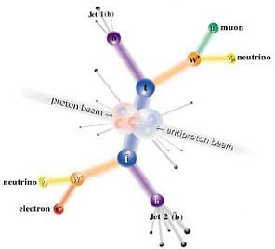
Electrons (leptons) vs. Protons (hadrons)
Electrons are point-like
Well-defined initial state
Full energy available to interaction
Can calculate from first principles
Can use energy/momentum conservation to find “invisible” particles.
Protons are made of quarks and gluons
Interaction take place between these consituents.
At high energies, virtual “sea” particles dominate
Only a small fraction of energy available, not well-defined.
Rest of particle fragments -> big mess!
So why don’t we stick to electrons??

Slide 39
Synchrotron Radiation: a Blessing and a Curse
As the trajectory of a charged particle is deflected, it emits “synchrotron radiation”
Radius of curvature
An electron will radiate about 10¹³ times more power than a proton of the same energy!!!!
Protons: Synchrotron radiation does not affect kinematics very much
Electrons: Beyond a few MeV, synchrotron radiation becomes very important, and by a few GeV, it dominates kinematics - Good Effects: - Naturally “cools” beam in all dimensions - Basis for light sources, FEL’s, etc. - Bad Effects: - Beam pipe heating - Exacerbates beam-beam effects - Energy loss ultimately limits circular accelerators

Slide 40
Practical Consequences of Synchrotron Radiation
Proton accelerators
Synchrotron radiation not an issue to first order
Energy limited by the maximum feasible size and magnetic field.
Electron accelerators
To keep power loss constant, radius must go up as the square of the energy (B proportional to 1/E ➔ weak magnets, BIG rings):
The LHC tunnel was built for LEP, and e⁺e⁻ collider which used the 27 km tunnel to contain 100 GeV beams (1/70th of the LHC energy!!)
Beyond LEP energy, circular synchrotrons have no advantage for e⁺e⁻
-> Linear Collider (a bit more about that later)
What about muons?
Point-like, but heavier than electrons
Unstable
More about that later, too…
Since the beginning, the energy frontier has belonged to proton (and/or antiproton) machines

Slide 41
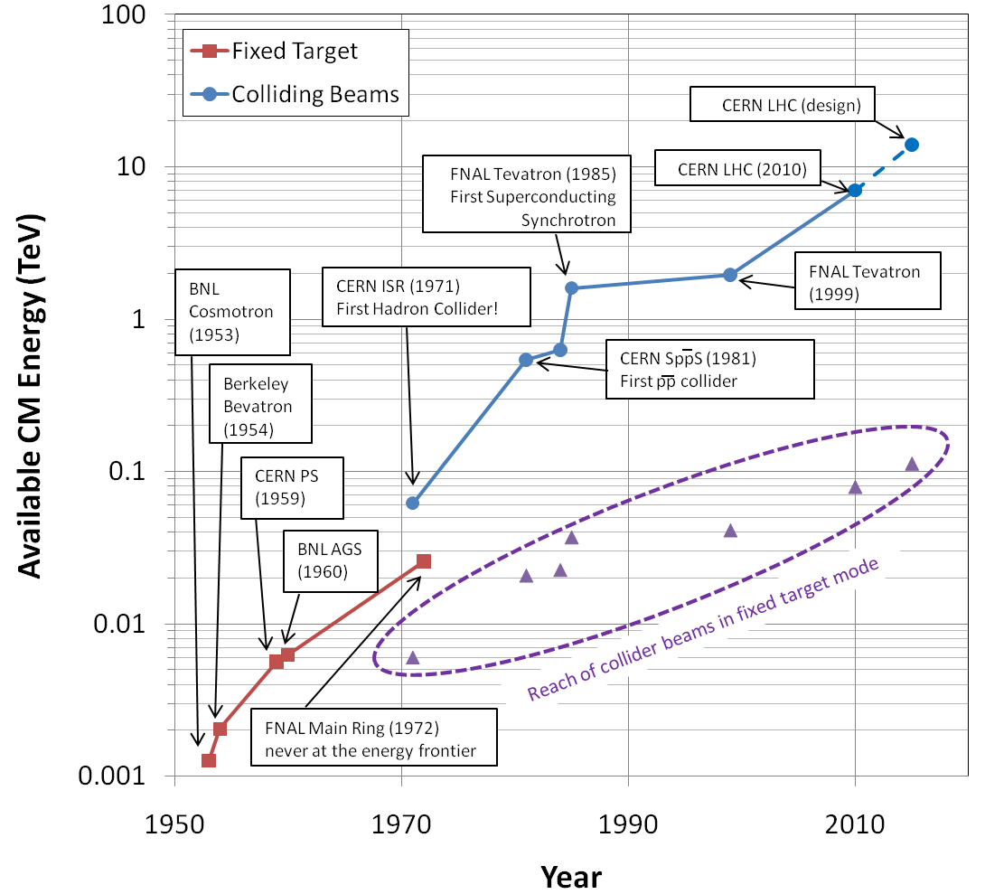
Evolution of the Energy Frontier
~a factor of 10 every 15 years

Slide 42
Luminosity
Rate
The relationship of the beam to the rate of observed physics processes is given by the “Luminosity”
Cross-section (“physics”)
“Luminosity”
Standard unit for Luminosity is cm⁻²s⁻¹ Standard unit of cross section is “barn”=10⁻²⁴ cm² Integrated luminosity is usually in barn⁻¹,where
nb⁻¹ = 10⁹ b⁻¹, fb⁻¹=10¹⁵ b⁻¹, etc
For (thin) fixed target:
Target thickness
Example: MiniBooNe primary target:
Incident rate
Target number density

Slide 43
Colliding Beam Luminosity
Circulating beams typically “bunched”
(number of interactions)
Cross-sectional area of beam
Total Luminosity:
Circumference of machine
Number of bunches
Record e+e- Luminosity (KEK-B): 2.11x10³⁴ cm⁻²s⁻¹ Record p-pBar Luminosity (Tevatron): 4.06x10³² cm⁻²s⁻¹ Record Hadronic Luminosity (LHC): 7.0x10³³ cm⁻²s⁻¹ LHC Design Luminosity: 1.00x10³⁴ cm⁻²s⁻¹

Slide 44
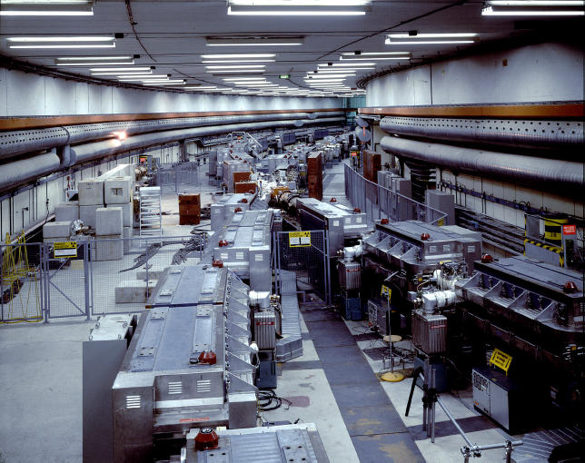
History: CERN Intersecting Storage Rings (ISR)
First hadron collider (p-p)
Highest CM Energy for 10 years
Until SppS
Reached it’s design luminosity within the first year.
Increased it by a factor of 28 over the next 10 years
Its peak luminosity in 1982 was 140x10³⁰ cm⁻²s⁻¹
a record that was not broken for 23 years!!

Slide 45
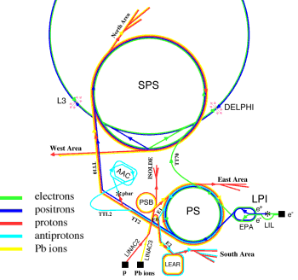
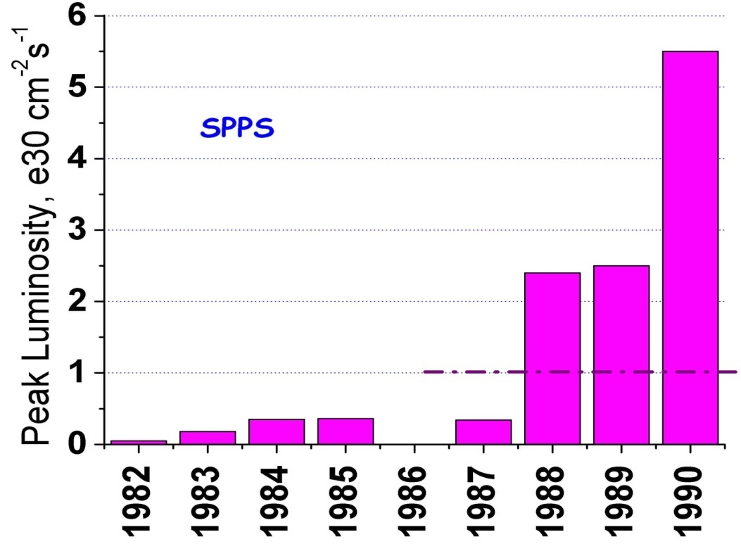
SppS: First proton-antiproton Collider
Protons from the SPS were used to produce antiprotons, which were collected
These were injected in the opposite direction and accelerated
First collisions in 1981
Discovery of W and Z in 1983
Nobel Prize for Rubbia and Van der Meer
Energy initially 270+270 GeV
Raised to 315+315 GeV
Limited by power loss in magnets!
Peak luminosity: 5.5x10³⁰cm⁻²s⁻¹
~.2% of current LHC
design

Slide 46
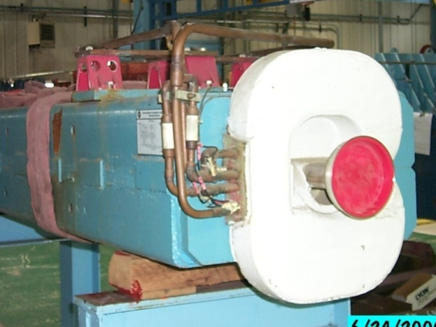
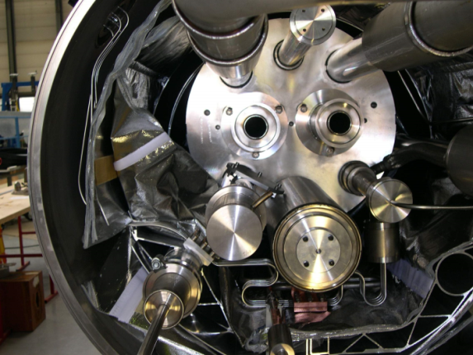
Superconductivity: Enabling Technology
The maximum SppS energy was limited by the maximum power loss that the conventional magnets could support in DC operation
P = I²R proportional to B²
Maximum practical DC field in conventional magnets ~1T
LHC made out of such magnets would be roughly the size of Rhode Island!
Highest energy colliders only possible using superconducting magnets
Must take the bad with the good
Conventional magnets are Superconducting magnets are simple and naturally dissipate complex and represent a great energy as they operate deal of stored energy which must be handled if something goes wrong

Slide 47
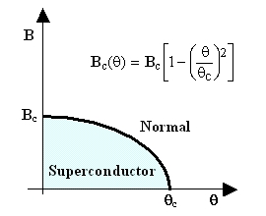
When is a superconductor not a superconductor?
Superconductor can change phase back to normal conductor by crossing the “critical surface”
When this happens, the conductor heats quickly, causing the surrounding conductor to go normal and dumping lots of heat into the liquid Helium➔“quench
all of the energy stored in the magnet must be dissipated in some way
Dealing with quenches is the single biggest issue for any superconducting synchrotron!
Can push the B field (current) too high
Can increase the temp, through heat leaks, deposited energy or mechanical deformation
T_{c}

Slide 48

Quench Example: MRI Magnet*
*pulled off the web. We recover our Helium.

Slide 49
Magnet “training”
As new superconducting magnets are ramped, electromechanical forces on the conductors can cause small motions.
The resulting frictional heating can result in a quench
Generally, this “seats” the conductor better, and subsequent quenches occur at a higher current.
This process is knows as “training”

Slide 50
Milestones on the Road to a Superconducting Collider
1911 – superconductivity discovered by Heike Kamerlingh Onnes
1957 – superconductivity explained by Bardeen, Cooper, and Schrieffer
1972 Nobel Prize (the second for Bardeen!)
1962 – First commercially available superconducting wire
NbTi, the “industry standard” since
1978 – Construction began on ISABELLE, first superconducting collider (200 GeV+200 GeV) at Brookhaven.
1983, project cancelled due to design problems, budget overruns, and competition from…

Slide 51
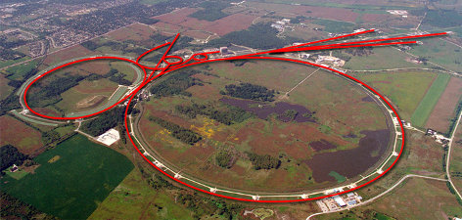
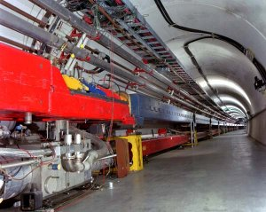
Fermilab: A brief history
1968 – Construction Begins
1972 – First 200 GeV beam in the Main Ring (400 GeV later that year)
Original director soon began to plan for a superconducting ring to share the tunnel with the Main Ring
Dubbed “Saver Doubler” (later “Tevatron”)
1982 – Magnet installation complete
1985 – First proton-antiproton collisions observed at CDF (1.6 TeV CoM). Most powerful accelerator in the world for the next quarter century
Late 1990’s – major upgrades to increase luminosity, including separate ring (Main Injector) to replace Main Ring
2011 – Tevatron shut down after successful LHC startup
Main Ring
Tevatron

Slide 52
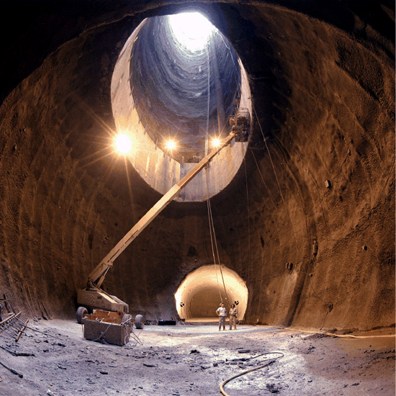
A Detour on the Road to Higher Energy
1980’s - US begins planning in earnest for a 20 TeV+20 TeV “Superconducting Super Collider” or (SSC).
87 km in circumference!
Considered superior to the “Large Hadron Collider” (LHC) then being proposed by CERN.
1987 – site chosen near Dallas, TX
1989 – construction begins
1993 – amidst cost overruns and the end of the Cold War, the SSC is cancelled after 17 shafts and 22.5 km of tunnel had been dug.
2001 – After the end of the LEP program at CERN, work begins on reusing the 27 km tunnel for the 7 TeV+ 7 TeV LHC

Slide 53
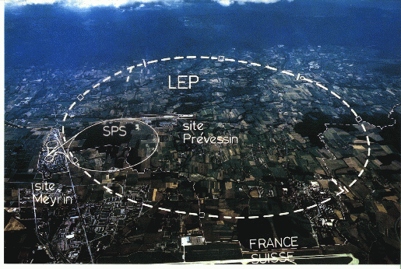
LHC: Location, Location, Location…
My House (1990-1992)
/LHC
Tunnel originally dug for LEP
Built in 1980’s as an electron positron collider
Max 100 GeV/beam, but 27 km in circumference!!

Slide 54
Partial LHC Timeline
1994:
The CERN Council formally approves the LHC
1995:
LHC Technical Design Report
2000:
LEP completes its final run
First dipole delivered
2005
Civil engineering complete (CMS cavern)
First dipole lowered into tunnel
2007
Last magnet delivered
First sector cold
All interconnections completed
2008
Accelerator complete
Last public access
Ring cold and under vacuum
September 10th: First circulating beam
September 19th: BAD accident brings beam down for almost 2 years
2010
Beam circulates again at reduced energy

Slide 55
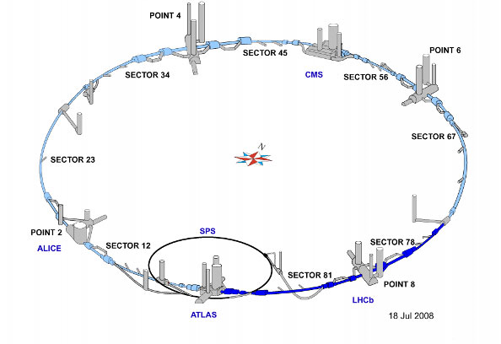
LHC Layout
8 crossing interaction points (IP’s)
Accelerator sectors labeled by which points they go between
ie, sector 3-4 goes from point 3 to point 4

Slide 56
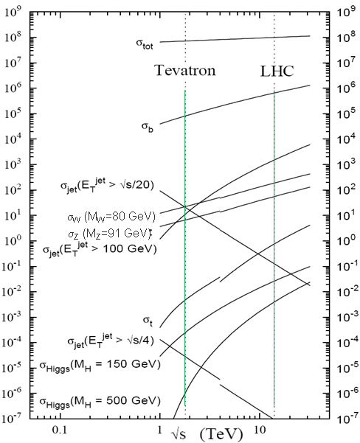
Nominal LHC Parameters Compared to Tevatron
Parameter | Tevatron | “nominal” LHC
Circumference | 6.28 km (2*PI) | 27 km
Beam Energy | 980 GeV | 7 TeV
Number of bunches | 36 | 2808
Protons/bunch | 275x10⁹ | 115x10⁹
pBar/bunch | 80x10⁹ | -
Stored beam energy | 1.6 + .5 MJ | 366+366 MJ*
Magnet stored energy | 400 MJ | 10 GJ
Peak luminosity | 3.3x10³² cm⁻²s⁻¹ | 1.0x10³⁴ cm⁻²s⁻¹
Main Dipoles | 780 | 1232
Bend Field | 4.2 T | 8.3 T
Main Quadrupoles | ~200 | ~600
Operating temperature | 4.2 K (liquid He) | 1.9K (superfluid He)
Increase in cross section of up to 5 orders of magnitude for some physics processes
*Each beam = TVG@150 km/hr ➔ very scary numbers
1.0x10³⁴ cm⁻²s⁻¹ ~ 50 fb⁻¹/yr= ~5 x total TeV data

Slide 57
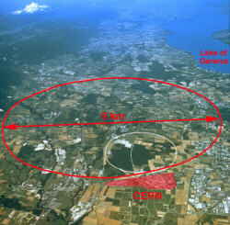
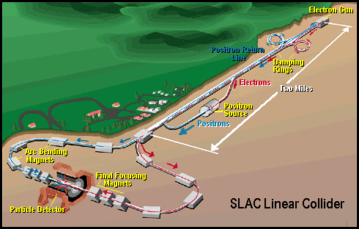
Some other important accelerators (past):
LEP (at CERN):
27 km in circumference - e+e- - Primarily at 2E=M_{Z} (90 GeV) - Pushed to E_{CM}=200GeV - L = 2E31 - Highest energy circular e+e- collider that will ever be built. - Tunnel now houses LHC
SLC (at SLAC):
2 km long LINAC accelerated electrons AND positrons on opposite phases. - 2E=M_{Z} (90 GeV) - polarized - L = 3E30 - Proof of principle for linear collider

Slide 58
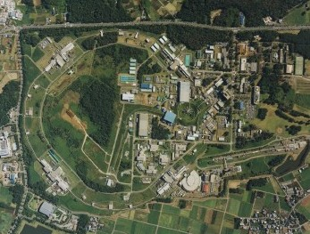
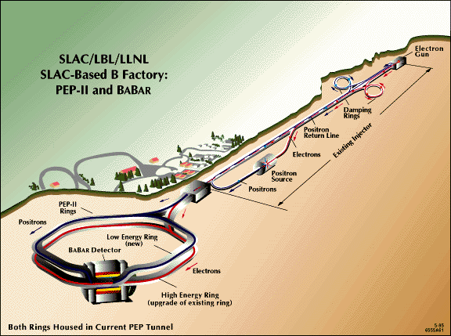
B-Factories
- B-Factories collide e+e- at E_{CM} = M(ϒ(4S)). -Asymmetric beam energy (moving center of mass) allows for time-dependent measurement of B-decays to study CP violation.
KEKB (Belle Experiment):
- Located at KEK (Japan) - 8GeV e- x 3.5 GeV e+ - Peak luminosity >1e34
PEP-II (BaBar Experiment)
- Located at SLAC (USA) - 9GeV e- x 3.1 GeV e+ - Peak luminosity >1e34

Slide 59
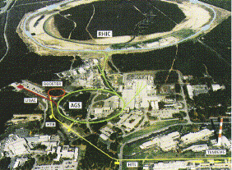
Relativistic Heavy Ion Collider (RHIC)
- Located at Brookhaven:
Can collide protons (at 28.1 GeV) and many types of ions up to Gold (at 11 GeV/amu).
Luminosity: 2E26 for Gold
Goal: heavy ion physics, quark-gluon plasma, ??

Slide 60
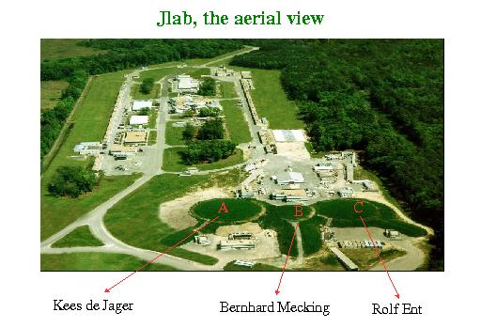
Continuous Electron Beam Accelerator Facility (CEBAF)
Locate at Jefferson Laboratory, Newport News, VA
6GeV e- at 200 uA continuous current
Nuclear physics, precision spectroscopy, etc

Slide 61
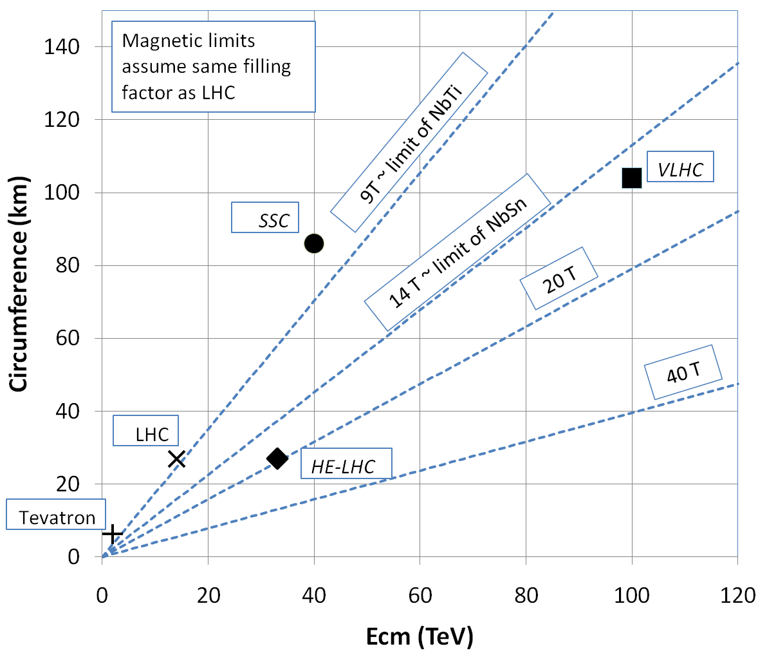
What next?
The energy of Hadron colliders is limited by feasible size and magnet technology. Options:
Get very large (eg, VLHC > 100 km circumference)
More powerful magnets (requires new technology)

Slide 62
Superconductor Options
Traditional
NbTi
Basis of ALL superconducting accelerator magnets to date
Largest practical field ~8T
Nb₃Sn
Advanced R&D
Being developed for large aperture/high gradient quadrupoles
Larges practical field ~14T
High Temperature
Industry is interested in operating HTS at moderate fields at LN₂ temperatures. We’re interested in operating them at high fields at LHe temperatures.
MnB₂
promising for power transmission
can’t support magnetic field.
YBCO
very high field at LHe
no cable (only tape)
BSCCO (2212)
strands demonstrated
unmeasureably high field at LHe
Focusing on this, but very expensive
➔ pursue hybrid design

Slide 63
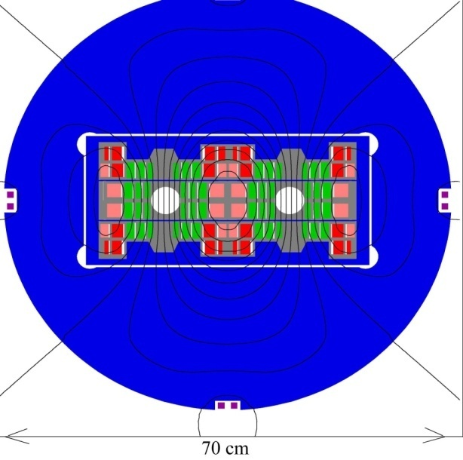
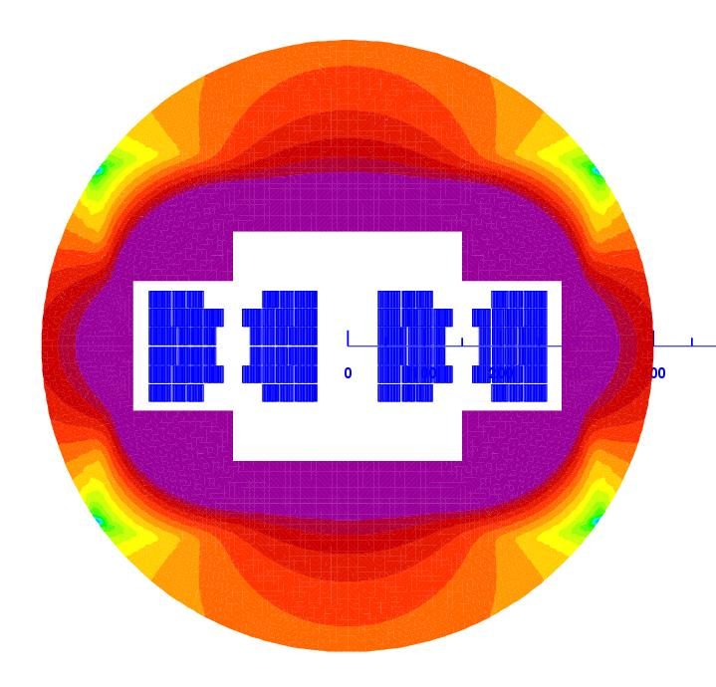
Potential Designs
P. McIntyre 2005 – 24T ss Tripler, a lot of Bi-2212 , Je = 800 A/mm2
E. Todesco 2010
20 T, 80% ss
30% NbTi
55 %NbSn
15 %HTS
All Je < 400 A/mm2

Slide 64
Other Paths to the Energy Frontier
Leptons vs. Hadrons revisited
Because 100% of the beam energy is available to the reaction, a lepton collider is competitive with a hadron collider of ~5-10 times the beam energy (depending on the physics).
A lepton collider of >1 TeV/beam could compete with the discovery potential of the LHC
A lower energy lepton collider could be very useful for precision tests, but I’m talking about direct energy frontier discoveries.
Unfortunately, building such a collider is VERY, VERY hard
Eventually, circular e⁺e⁻ colliders will radiate away all of their energy each turn
LEP reached 100 GeV/beam with a 27 km circuference synchrotron!
➔ Next e⁺e⁻ collider will be linear

Slide 65
International Linear Collider (ILC)
LEP was the limit of circular e⁺e⁻ colliders
Next step must be linear collider
Proposed ILC 30 km long, 250 x 250 GeV e⁺e⁻ (NOT energy frontier)
We don’t yet know whether that’s high enough energy to be interesting
Need to wait for LHC results
What if we need more?

Slide 66
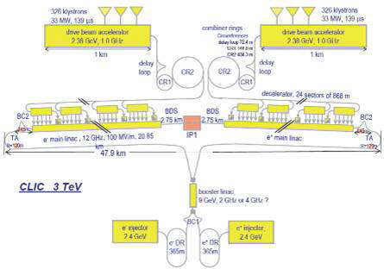
“Compact” (ha ha) Linear Collider (CLIC)?
Use low energy, high current electron beams to drive high energy accelerating structures
Up to 1.5 x 1.5 TeV, but VERY, VERY hard

Slide 67
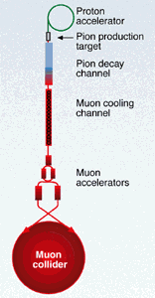
Muon colliders?
Muons are pointlike, like electrons, but because they’re heavier, synchrotron radiation is much less of a problem.
Unfortunately, muons are unstable, so you have to produce them, cool them, and collide them, before they decay.

Slide 68
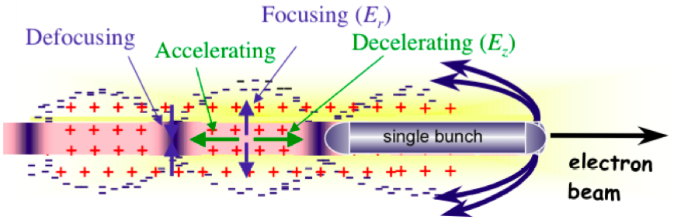
Wakefield accelerators?
Many advances have been made in exploiting the huge fields that are produced in plasma oscillations.
Potential for accelerating gradients many orders of magnitude beyond RF cavities.
Still a long way to go for a practical accelerator.

Slide 69
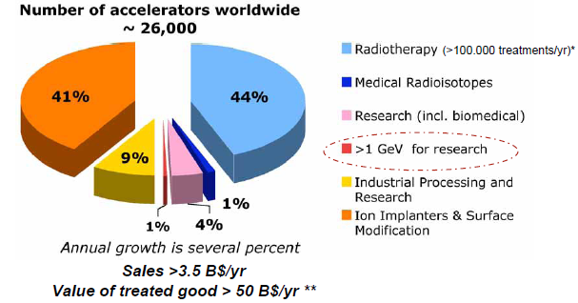
Research Machines: Just the Tip of the Iceberg

Slide 70
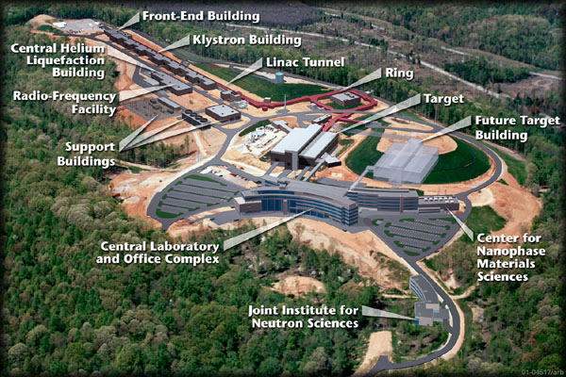
Example: Spallation Neutron Source (Oak Ridge, TN)
A 1 GeV Linac will load 1.5E14 protons into a non-accelerating synchrotron ring.
These are fast extracted onto a Mercury target
This happens at 60 Hz -> 1.4 MW
Neutrons are used for biophysics, materials science, industry, etc…

Slide 71
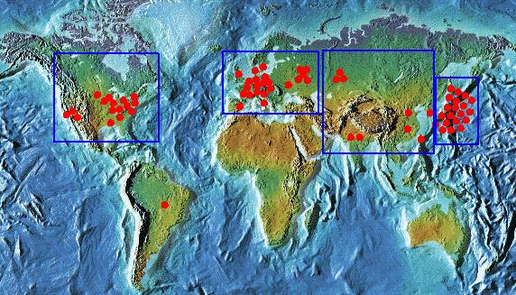

Light sources: too many to count
Put circulating electron beam through an “undulator” to create synchrotron radiation (typically X-ray)
Many applications in biophysics, materials science, industry.
New proposed machines will use very short bunches to create coherent light.

Slide 72

Other uses of accelerators
Radioisotope production
Medical treatment
Electron welding
Food sterilization
Catalyzed polymerization
Even art…
In a “Lichtenberg figure”, a low energy electron linac is used to implant a layer of charge in a sheet of lucite. This charge can remain for weeks until it is discharged by a mechanical disruption.

